Slide 1
AI & Security Project
Using adversarial attacks to cause misclassification
Group 1
Harman Singh
Sadiksha Sapkota

Slide 2
Project overview
Project 2.2
Part 1: Adversarial Attacks on Image Classification Models
Investigate the vulnerability of image classification models to adversarial attacks
Use pre-trained image classifiers
Explore adversarial attack methods
Part 2: Defense Mechanisms against Adversarial Attacks
Explore and investigate defense techniques that enhance robustness

Slide 3
Implementation
Part 1: Attack
Dataset: TinyImageNet, Pretrained patches
Attacks:
Method 1: Adversarial attacks (FGSM, PGD, C&W)
Method 2: Adversarial patches (SGD)
Pre-trained models:
Method 1: ResNet18, ResNet50, ResNet152, VGG16, VGG19
Method 2: ResNet34, DensNet12
Part 2: Defense
Mechanism: Adversarial training

Slide 4
Workflow of method 1 – Adversarial attacks
Evaluation order
baseline performance (without attack)
attack performance (with all attacks)
defense performance (with defense against all attacks)
Metrics
Top-1 error: the number of times the correct class was not the predicted class
Top-5 error: the number of times the correct class was not in the top 5 predicted classes by certainty

Slide 5
Workflow of method 2 – Adversarial patches
Terminology: Adversarial patches are small, specially made images or patterns designed to trick AI models into making incorrect predictions.
Here we have 5 pretrained patches so that we can fool the network into the desired label.
The pretrained patches include toaster, goldfish, school bus, lipstick, pineapple
We have for each patches 32 pixels, 48 pixels, 64 pixels.

Slide 6
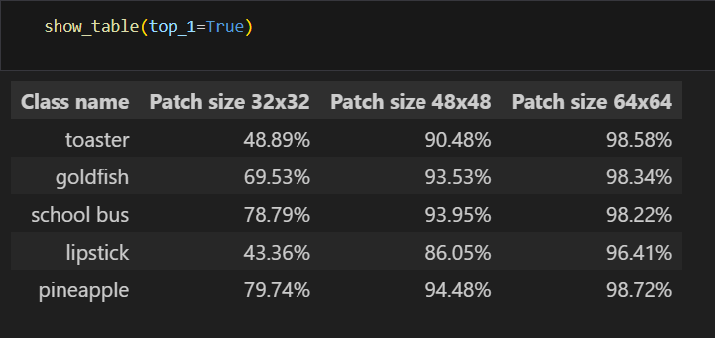
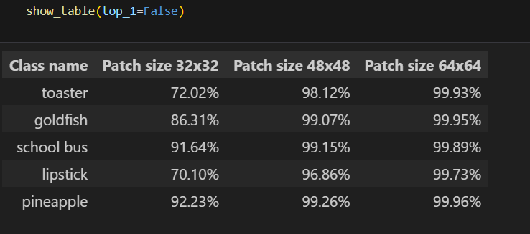
Workflow of method 2 – Adversarial patches
Accuracy: Top-1, Top-5

Slide 7
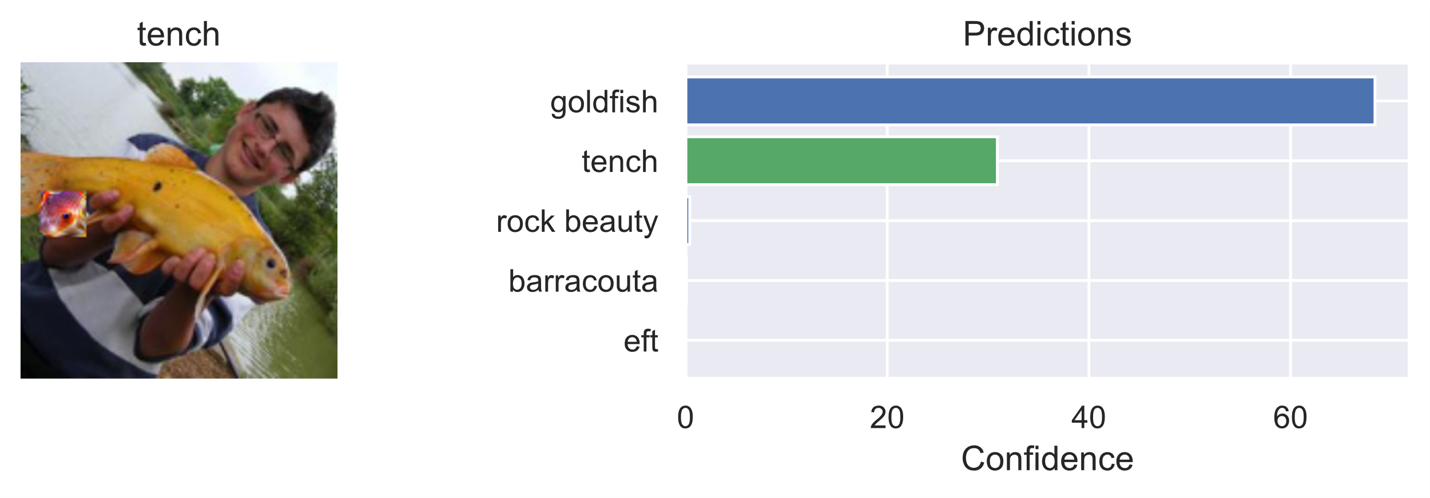
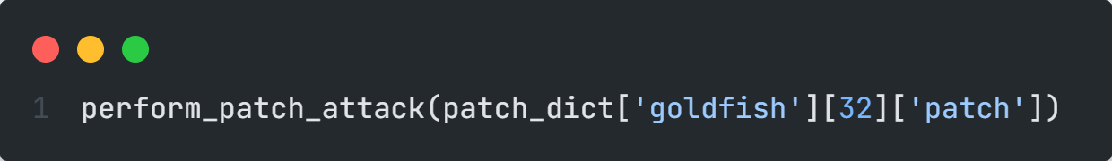
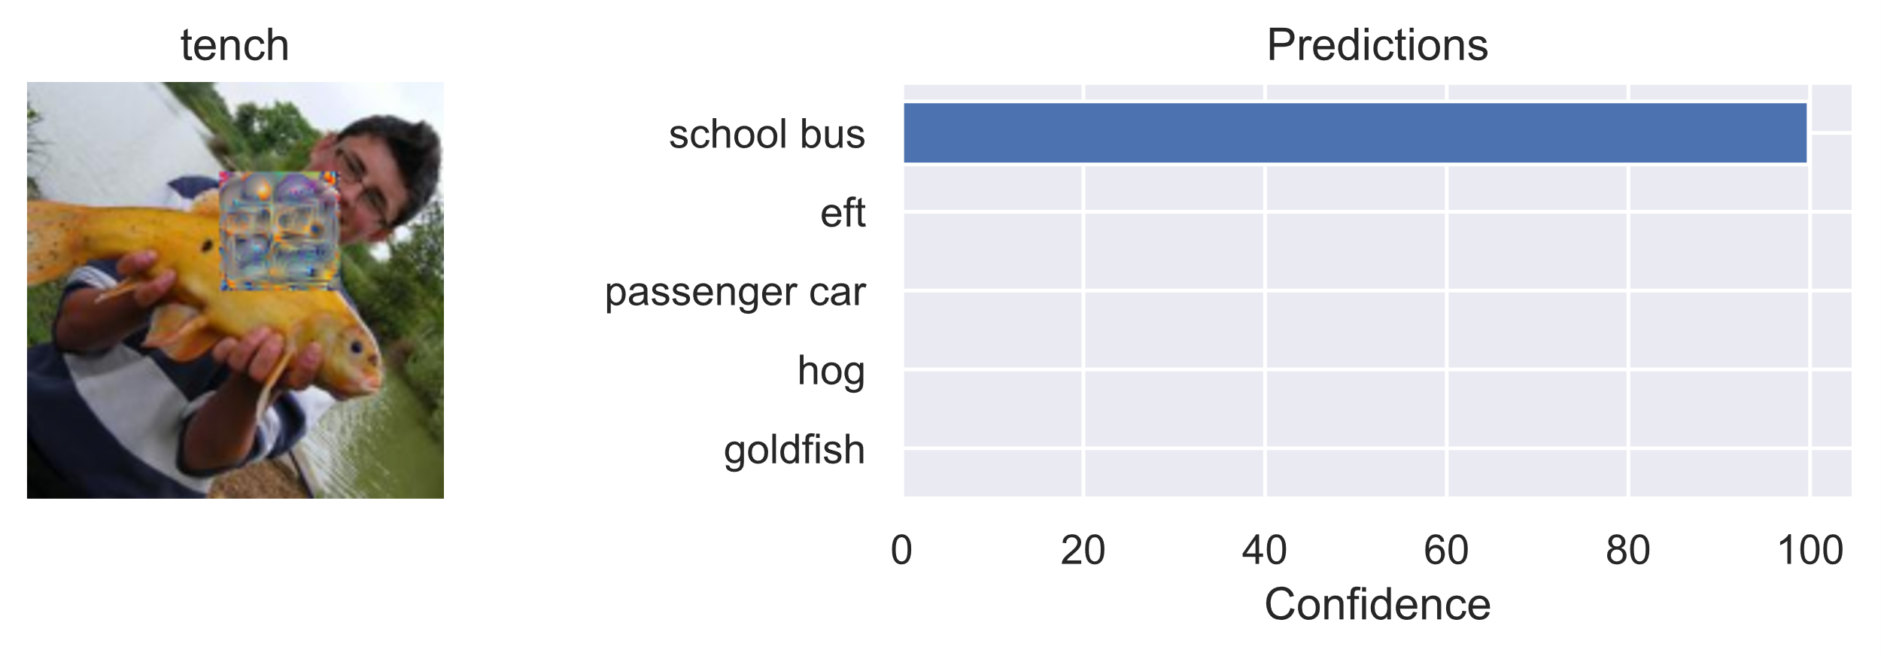
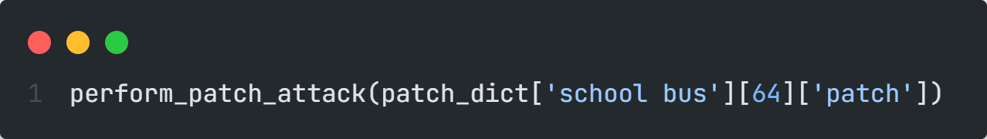
Workflow of method 2 – Adversarial patches

Slide 8
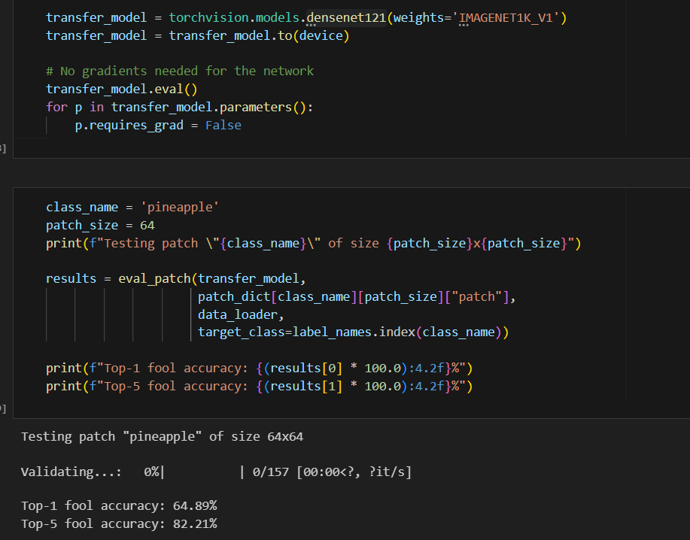
Workflow of method 2 – Adversarial patches
Transferability

Slide 9
Our findings
Attacking the models decreases model confidence, and increases likelihood of spreading predictions across multiple classes instead of just picking 1 class
The bigger the epsilon, the bigger the error
PGD was the most effective attack method (up to 500% increase in Top-1 error rate)
Adversarial training against PGD did not seem to improve the model’s performance as much
For ResNet18 and ResNet50, adversarial training made the model perform better after it had been attack, than the baseline performance
Adversarial training did not seem to have an impact on VGG16 nor VGG19

Slide 10
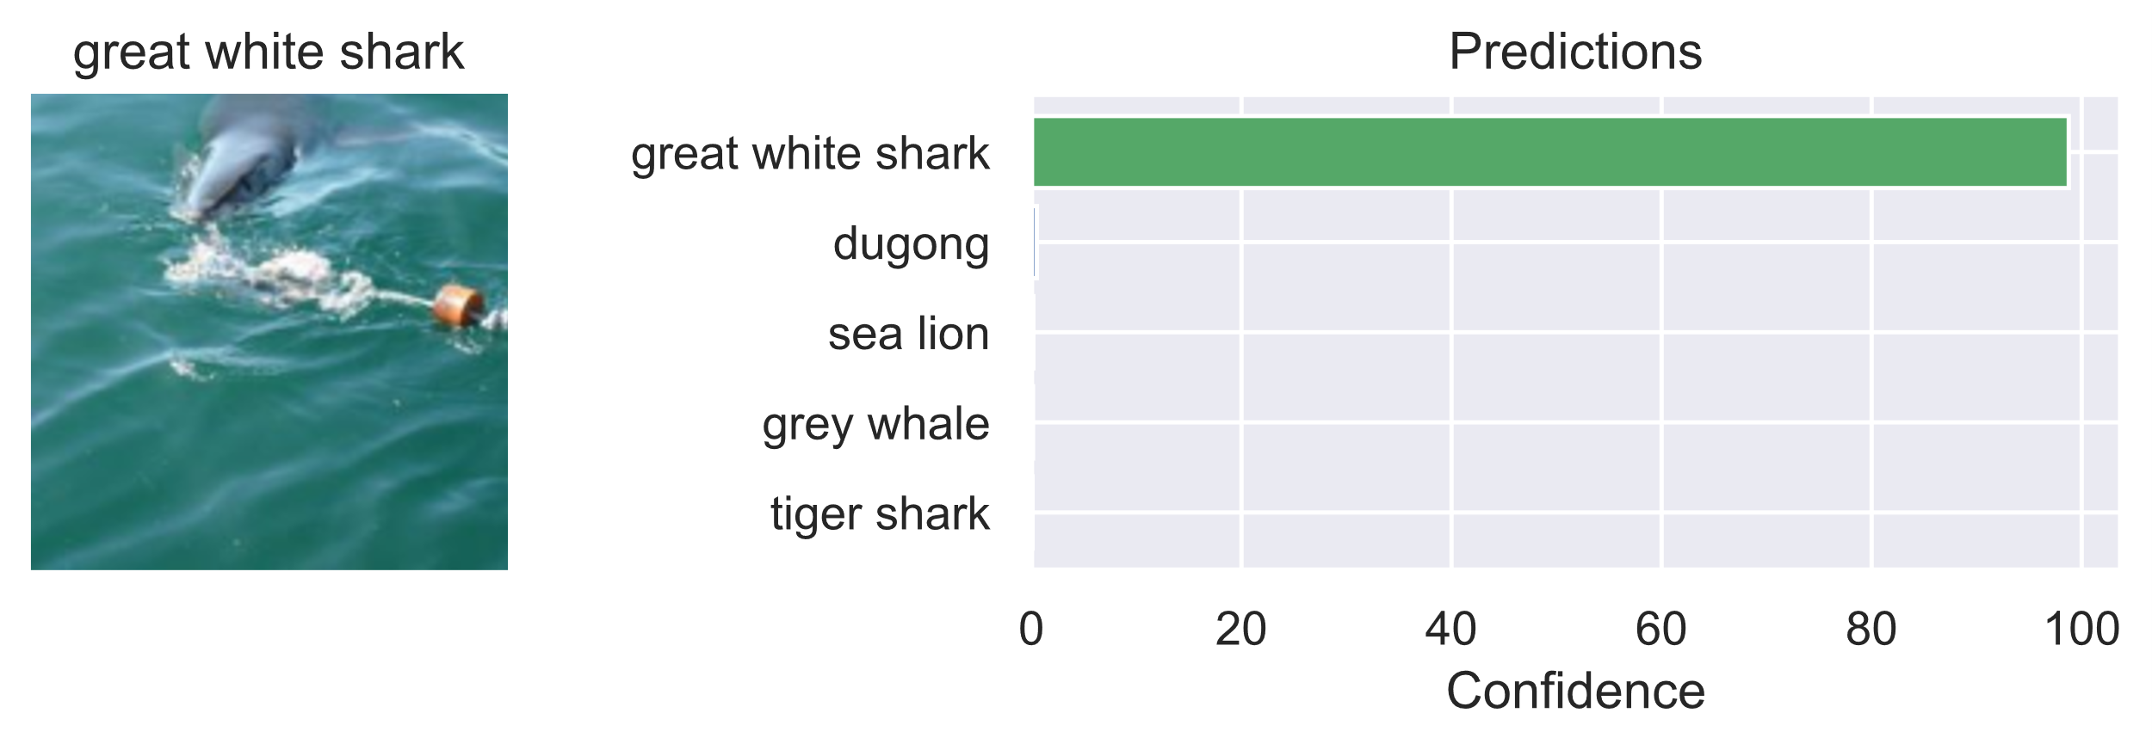
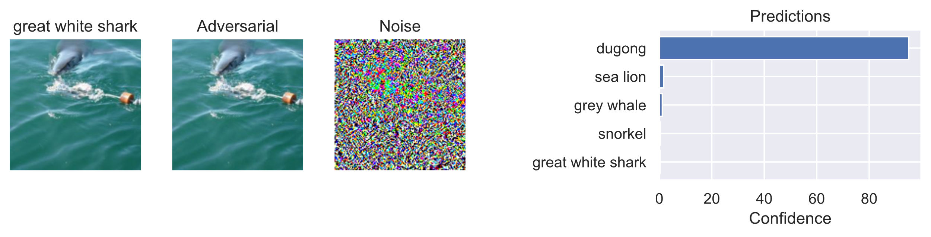
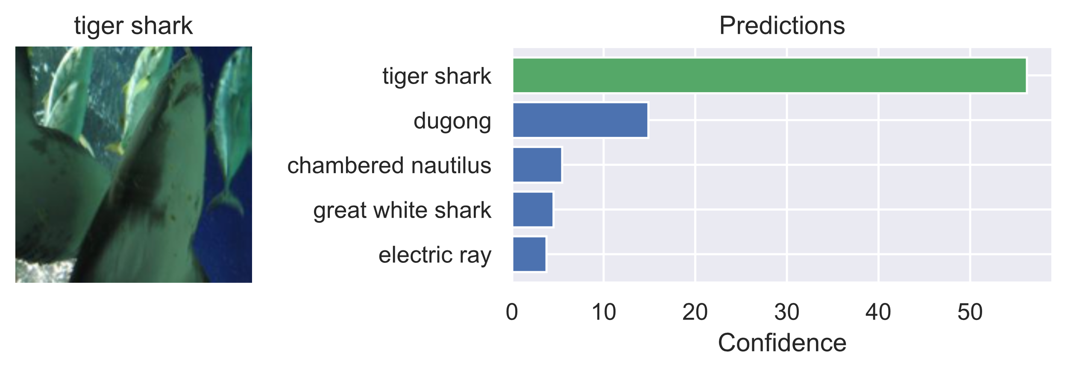
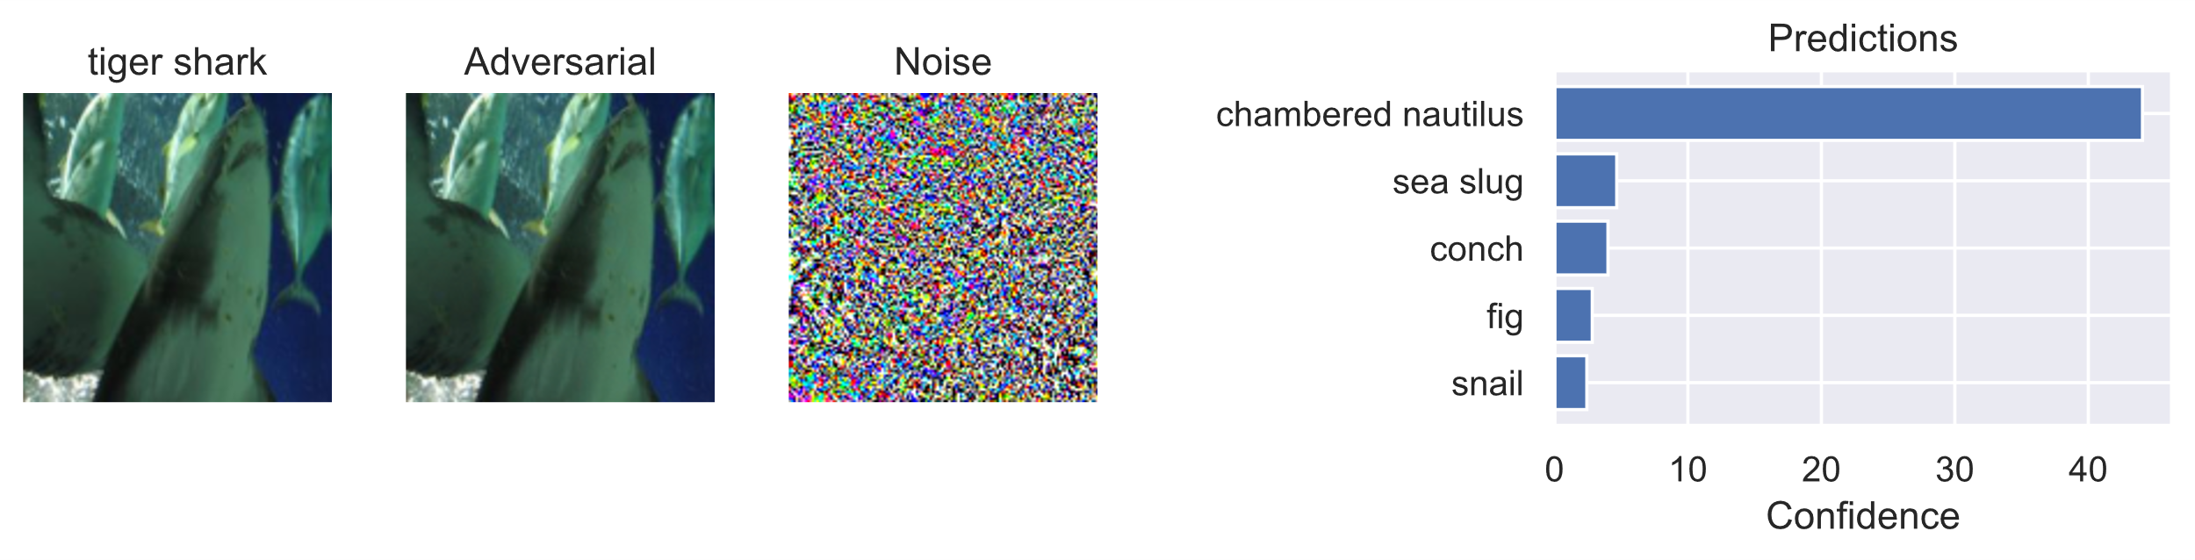
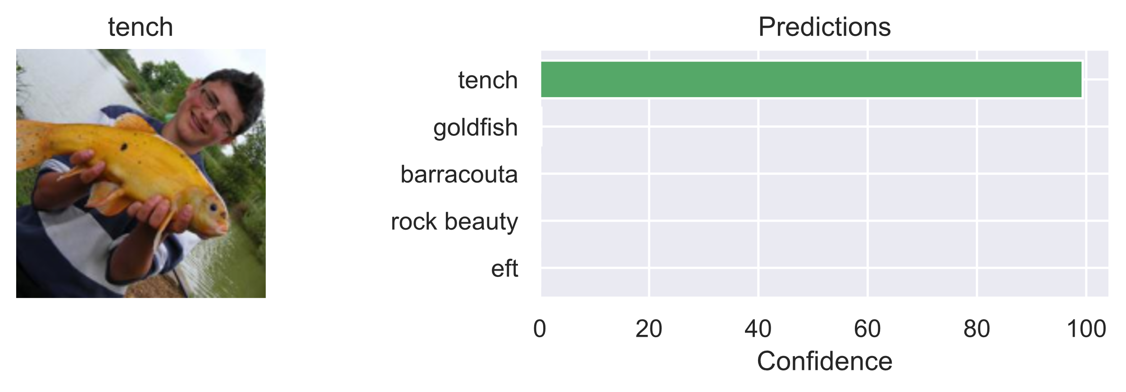
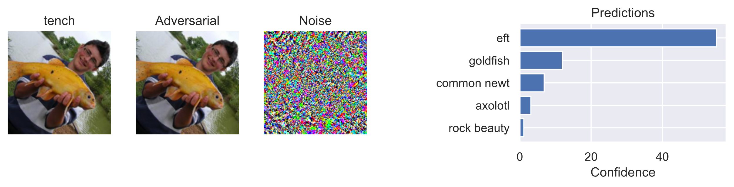
Our findings
Baseline
Attacked with FGSM

Slide 11
Our findings
Attacking the models decreases model confidence, and increases likelihood of spreading predictions across multiple classes instead of just picking 1 class
The bigger the epsilon, the bigger the error
PGD was the most effective attack method (up to 500% increase in Top-1 error rate)
Adversarial training against PGD did not seem to improve the model’s performance as much
For ResNet18 and ResNet50, adversarial training made the model perform better after it had been attack, than the baseline performance
Adversarial training did not seem to have an impact on VGG16 nor VGG19

Slide 12
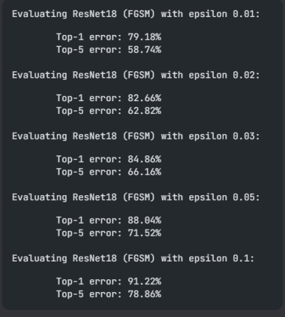
Our findings
The bigger the epsilon, the bigger the error finding precise number is not always easy

Slide 13
Our findings
Attacking the models decreases model confidence, and increases likelihood of spreading predictions across multiple classes instead of just picking 1 class
The bigger the epsilon, the bigger the error
PGD was the most effective attack method
Adversarial training against PGD did not seem to improve the model’s performance as much
For ResNet18 and ResNet50, adversarial training made the model perform better after it had been attack, than the baseline performance
Adversarial training did not seem to have an impact on VGG16 nor VGG19

Slide 14
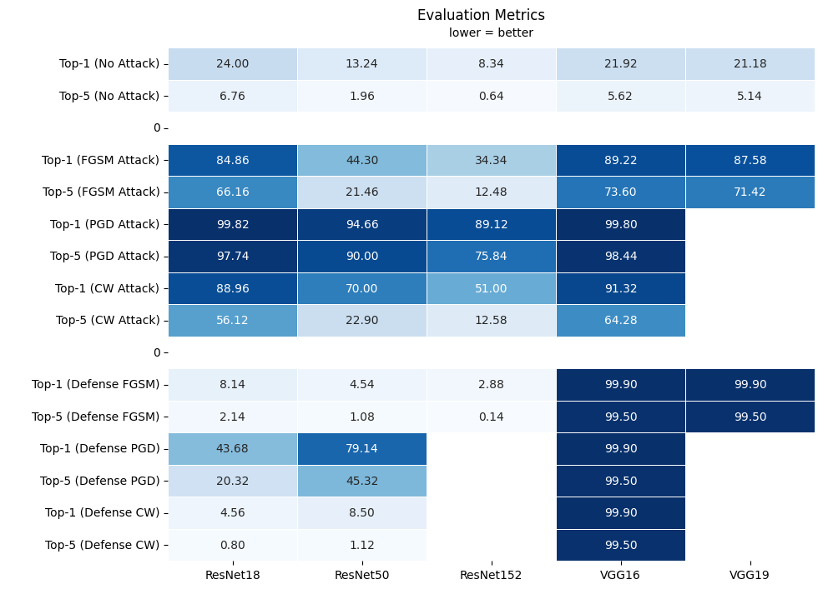

Slide 16
Our findings
Attacking the models decreases model confidence, and increases likelihood of spreading predictions across multiple classes instead of just picking 1 class
The bigger the epsilon, the bigger the error but finding percise.
PGD was the most effective attack method (up to 500% increase in Top-1 error rate)
Adversarial training against PGD did not seem to improve the model’s performance as much
For ResNet18 and ResNet50, adversarial training made the model perform better after it had been attack, than the baseline performance
Adversarial training did not seem to have an impact on VGG16 nor VGG19

Slide 18
Our findings
Attacking the models decreases model confidence, and increases likelihood of spreading predictions across multiple classes instead of just picking 1 class
The bigger the epsilon, the bigger the error but finding percise.
PGD was the most effective attack method (up to 500% increase in Top-1 error rate)
Adversarial training against PGD did not seem to improve the model’s performance as much
For ResNet18 and ResNet50, adversarial training made the model perform better after it had been attack, than the baseline performance
Adversarial training did not seem to have an impact on VGG16 nor VGG19

